Slide 1
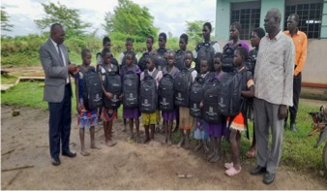
ANNUAL JOINT AIDS REVIEW
2023/24
Dr. Vincent Bagambe, Uganda AIDS Commission
November 13, 2024

Slide 2
Presentation outline
Introduction
The HIV Epidemic and Response at a Glance
  Status of the HIV epidemic:
  Progress on 95-95-95
NSP implementation
  Prevention
  Care and Treatment
  Social support and social protection
  Systems Strengthening
Progress on PFTI Targets
Key issues & Way forward
Notes:
This presentation will highlight;
The current status of the HIV epidemic;
Progress on the NSP implementation by thematic area;
highlights on the progress on the Presidential Fast Track Initiative, as well as
key challenges to the HIV response to date.

Slide 3
Introduction and Background
In 2020, Uganda developed the 2020/21-2024/25 NSP for the HIV response
Each year UAC & stakeholders convene to review progress on its implementation
The scope for this year’s JAR covered;
  4th year of implementing the NSP,
  7th year for the Presidential Fast Track Initiative (PFTI), and
  8th year of reporting on the SDGs
  Review and disseminate progress on implementation of undertakings of the Aide Memoire, JAR 2023

Slide 4
Methodology
A multi-sectoral team was constituted and given clear TORs to draft the report :
  Document Review: Several documents were reviewed by the TWGs, facilitator, and stakeholders
  Secondary data analysis based on data from stakeholder databases and systems such as DHIS2, HIBRID, KP Tracker etc
  The other documents reviewed included; the GAM report; HIV and AIDS estimates; the 2023 UDHS and NASA reports, etc….
  Stakeholder consultations with MoH, TWGs, ADPG, Program Managers, Community Groups
Self-Coordinating Entities (SCE) were supported to compile their respective quarterly reports which informed the progress on implementation of JAR 2023 undertakings

Slide 5
Performance on Key HIV indicators
Impact Indicator | Baseline 2020/21 | Target By 2025 | Achievements |  |  |  | Remarks
 |  |  | 2020/21 | 2021/22 | 2022/23 | 2023/24
Estimated PLHIVs |  |  | 1,414,183 | 1,420,020 | 1,433,337 | 1,492,410 |  | M: 582,410 F: 910 000
HIV Incidence Rate: Adults (15-49) | 0.32% | 0.2% | 0.24% | 0.23% | 0.22% | 0.16% |  | On Track
HIV Prevalence, Adults 15-49 yrs | 5.5% |  | 5.2% | 5.2% | 5.1% | 5.1% |  | Declining Female: 6.5% Male: 3.6%
New Infections (adults and Children) | 54,000 | 18,200 | 54,000 | 45,000 | 42,000 | 38,000 |  | Declined. But not among AGYW & target unlikely to be met by 2025
% HIV Exposed Infants testing +ve at 6 weeks | 2.1% | 1.3% | 3% | 3% | 2.6% | 3.05% |  | Increasing. 5.04% at 18 months. Source: MOH HIV Estimates 2023
Annual AIDS related Deaths | 21,000 | 10,800 | 18,000 | 17,000 | 17,466 | 20,000 |  | Stagnating. Target unlikely to be met. Adults 15+: 16,558 Children <15: 3,165
Source: MOH Country Spectrum Estimates 2022
Notes:
Looking at key HIV indicators,
HIV prevalence is declining, though still higher among women 6.5% compared to men 3.6%
New HIV infections declining but not fast enough especially among AGYW, who make over 30% of all new HIV infections
However, more efforts are needed to reduce deaths among PLHIV as well as vertical HIV transmission from mother to child, if we are to meet the 2025 NSP targets.

Slide 6
Cascade performance: 92-90-94
Children and adolescents lagging on the 1st and 3rd 95
Notes:
Overall, 92% of the estimated number of People Living with HIV (PLHIV) have been identified, just 3% short of 2025 target of 95%
Of these, 90% are receiving HIV treatment, and among those on treatment / antiretroviral therapy, 94% are virally suppressed.
However, children and adolescents continue to lag behind, as the country is still having difficulty finding infected children (at 83%) and ensuring they are virally suppressed (only 82% are suppressed).

Slide 7
HIV PREVENTION

Slide 8
Key achievements
NEW HIV INFECTIONS DECLINED from 54,000 (2020/21) to 38,000 (2023/24)
  A new Medically Assisted Therapy (MAT) centre was opened at Mbale RRH
  The national AGYW program was reviewed, and the minimum service package revised for improved reach / coverage
  A service package targeting Adolescent Boys & Young Men was developed
  Condoms: Implemented 3rd phase of the last mile condom distribution, increasing consumption from 147,624,179 in 2022 to 171,253,889 in 2023
  New PrEP options were introduced, including event driven PrEP
  In PMTCT, over 95% of HIV infected mothers received ART.
HIV Testing: Over 8 million individuals were tested for HIV, of which 1.6% were HIV-Positive (144,651), and 95% linked to ART
Time-up Campaign was revamped for better reach of Adolescents and Youth
Notes:
In the 4 ^{years} of implementing the NSP,
New HIV infections have been on the decline, which can largely be attributed to implementation of the combination Prevention for HIV targeting Key and priority populations, as well as the general population.
For KPs, A new Medically Assisted Therapy (MAT) centre opened at Mbale RRH to support People who inject Drugs PWID
A service package targeting Adolescent Boys and Young Men (ABYM) was developed. Over ¾ of SMCs performed were among ABYM
The country implemented the 3rd phase of the last mile condom distribution, to reach hot spots in the community and increase condom access
In PMTCT, over 95% of HIV infected mothers received ART.
Over 8 million were tested for HIV and over 95% of the 144,000 found infected were linked to ART

Slide 9
AGYW
Revised the AGYW minimum service package to ease rollout nationally and reach more AGYW
Conducted the AGYW population size estimate (PSE) to guide planning
Integrated health and HIV in the school curriculum & established school health clubs
Over 543,990 AGYW were reached with HIV prevention packages in 44 Districts
Notes:
AGYW are one of the prioty populations for HIV prevention, with activities supported across various sectors including health, education, and gender.
In the year under review, over 543,000 girls and women were reached with AGYWs services
There was a review of the AGYW HIV program response which guided revision of the minimum service package
Additionally, we undertook a population size estimation for AGYW that improved our understanding of who needs the service and where they are
Integrated health and HIV in the school curriculum & established school health clubs in majority of schools

Slide 10
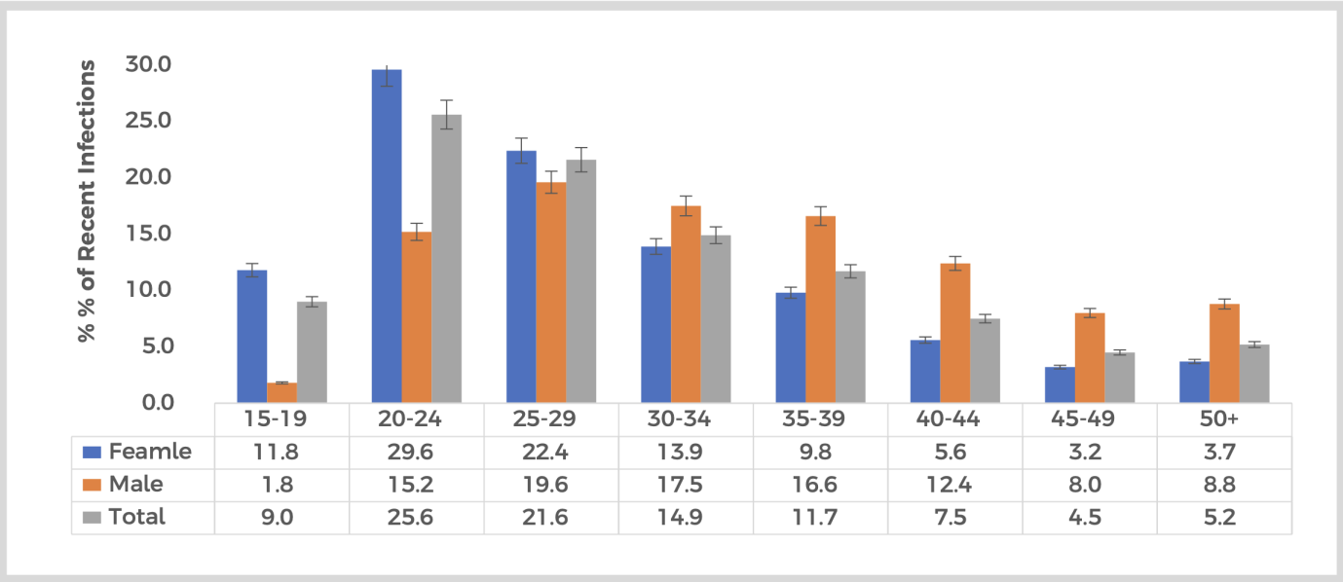
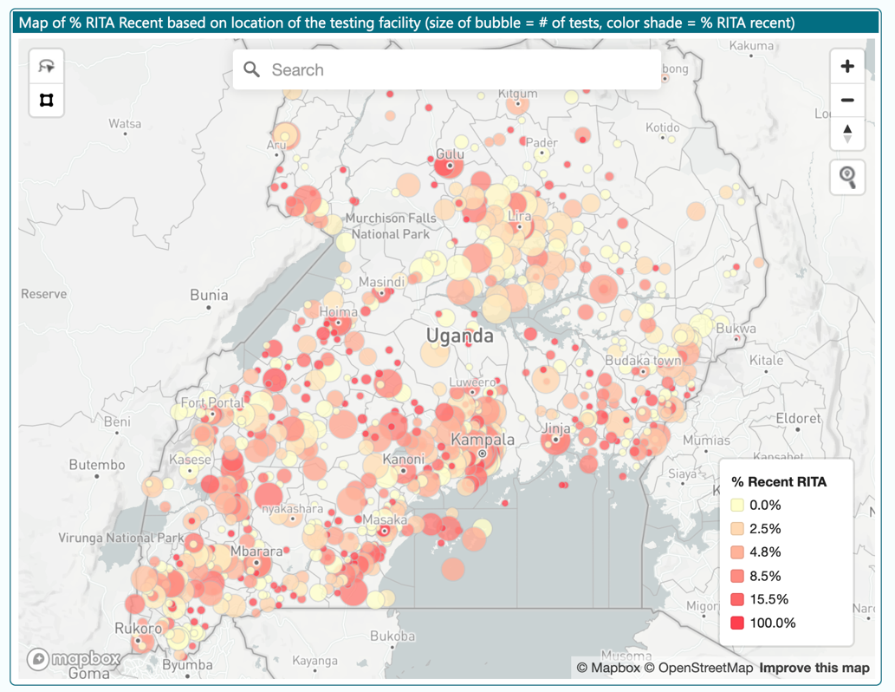
Recent HIV Infection Surveillance
Conducted among 23,976 individuals newly identified as HIV positive at 830 facilities,
8.3% were Recent HIV infections (i.e. <1 year)
Prevalence of recent infections is higher among females <30 yrs.
A Public Health Response (PHR) has been developed to guide use of hotspot information for epidemic control
Notes:
Implementation of recent HIV infection surveillance started in 2019 and roll out has been ongoing nationally.
Among 23,976 individuals newly identified as HIV positive at 830 facilities in 128 districts,
8.3% were recent HIV infections
Prevalence of recent infections is higher among females <30 yrs. However, above 30 years of age, the reverse is true with prevalence higher among males
This data comes in handy to guide a Public Health Response (PHR) by mapping out hotspots where new HIV infections are concentrated

Slide 11
PMTCT: Coverage HTS & ART > 95%
Key challenge:
Retention of Mother Baby pairs
  Month 12 after ART start: 86%
  EID within 2/12: 81%
Recommendation:
Enhance retention especially for young mothers who comprise 43% of pregnant WLHIV
Notes:
In PMTCT, over 98% of mothers attending ANC accessed HIV testing and 95% of the infected mothers received ART.
Among exposed infants, over 100% received ARV prophylaxis but there were gaps in accessing Early Infant Diagnosis testing within the recommended period of 2 months where only 81% were tested.
However, the key challenge is retention of the mother infant pairs - 86% were on ART 12 months after Hinitiation
Of note, 91% of pregnant women attended ANC but only 37% of these do attend within the first trimester, hence the majority start late

Slide 12
Scale-up of PrEP
Over 216,433 newly enrolled:
  Majority are Sex Workers & their Clients
Introduced new PrEP options
  Event-driven PreP
  Dapivirine vaginal ring
Key issues:
  Suboptimal coverage among the targeted groups
  Limited awareness about PrEP
  Low PrEP refills /continuity
  Need to avail all options including long term injectables
Notes:
Over 216,000 were newly enrolled on oral PrEP, majority of these being Sex Workers & their clients
New PrEP options were introduced, including event-driven PrEP, and the Dapivirine vaginal ring. New injectable options still undergoing research to ascertain viability before they can be introduced in Uganda
There is need to address gaps in knowledge, improve distribution mechanisms and ensure availability of all PrEP options, including long term injectable PrEP

Slide 13
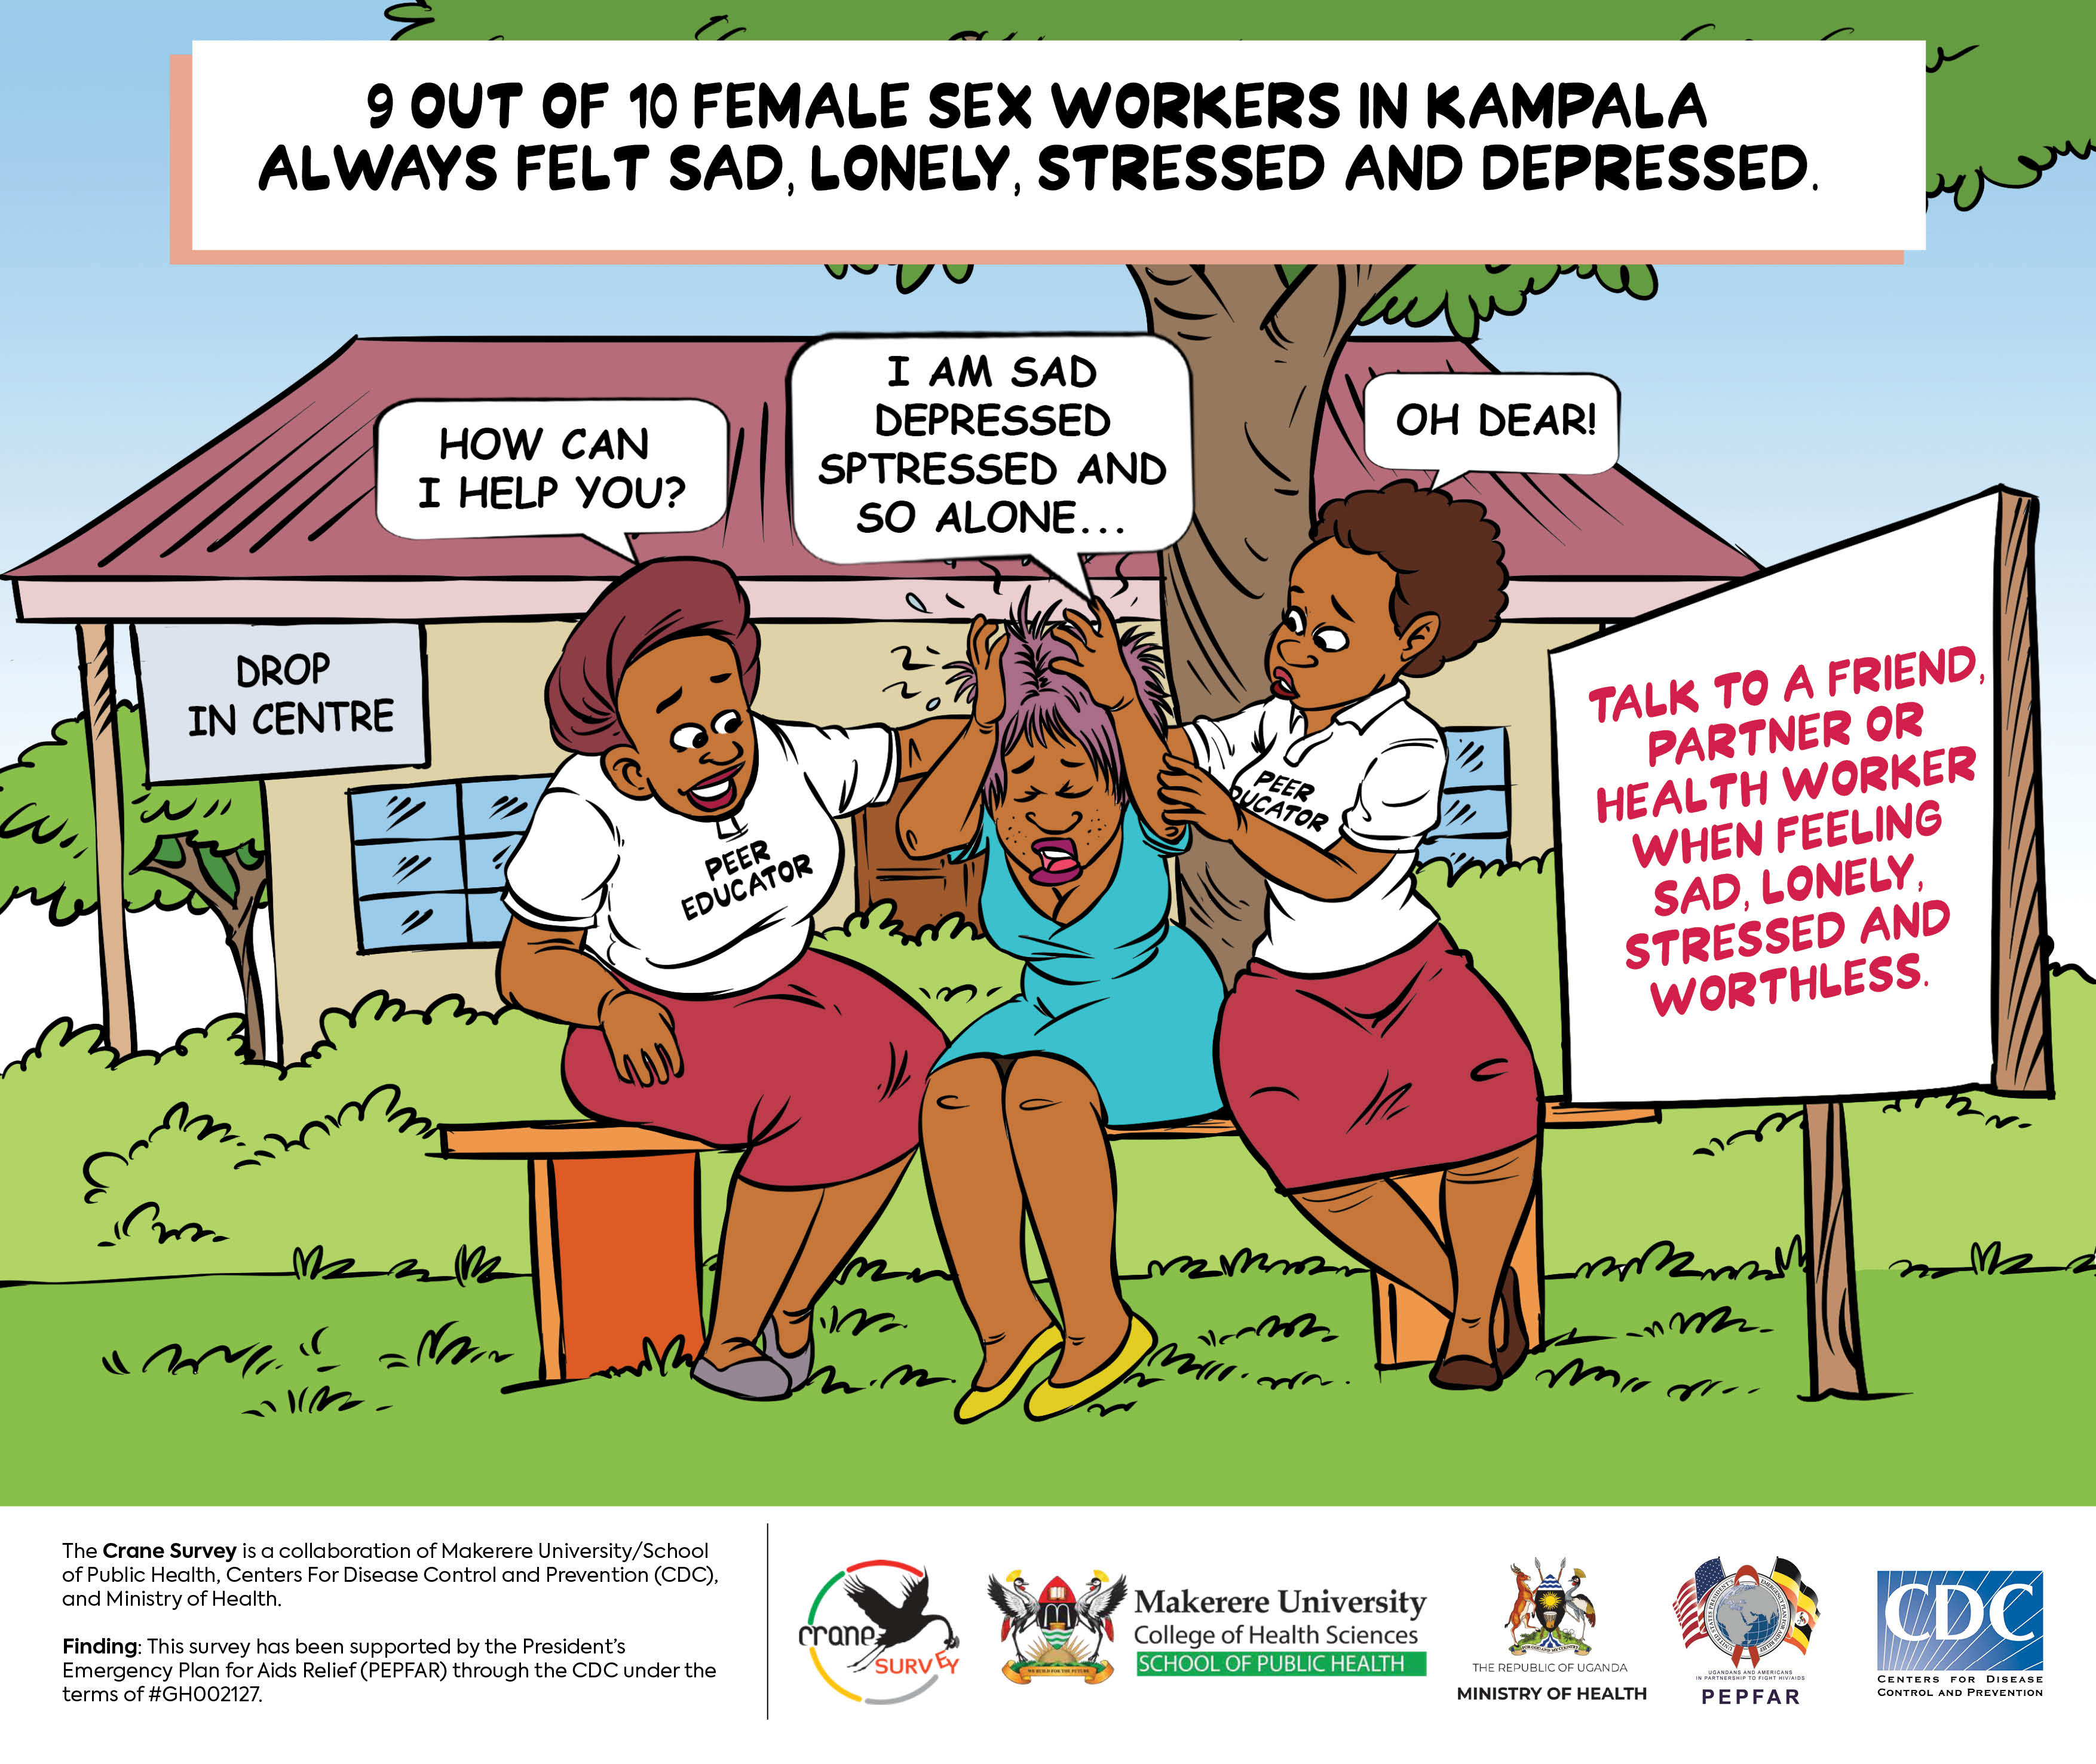
Comprehensive KP programming
Access to KP services maintained following AHA
Expanded access to Medically Assisted Therapy (MAT) for PWID: Mbale & Butabika
Implementing Integrated Biobehavioral Surveillance (IBBS); sentinel sites in 15 in all regions. Of note
  HIV prevalence 33% among Sex Workers
  Inconsistent uptake of HIV prevention (Condom use is high 84% but inconsistent; PrEP uptake suboptimal)
  High turnover of Sex Workers 2-3 yrs
  High levels of co-morbidities (HPV infection 36%; mental health challenges 90%)
  High levels of stigma, depression, alcohol, and drug use, as well as sexual violence (rape)
  Good HTS uptake – 96% ever tested
  Clinical cascade: 91-97-90
  Lack of updated population size estimates
Notes:
Following passing of the Antihomosexuality Act, access to health services by the KP population has been maintained though with some modification in delivery approaches
Through the Integrated biobehavioral surveillance initiative IBBS) , information on HIV prevalence, behavioral change, and uptake of services has been made available. Of note, among female sex workers seen,
HIV prevalence remains high at 33%
There is inconsistent uptake of HIV prevention services (Although Condom use is high at 84% , it is inconsistent, while PrEP uptakes is also suboptimal)
There is high turnover of Sex Workers i.e. every 2-3 yrs, which calls for continuous engagement
There are high levels of co-morbidities (HPV infection 36%; mental health challenges 90%; illicit drug use)
Sex workers experienced high levels of stigma, depression, alcohol, and drug use, as well as sexual violence (rape)
Good HTS uptake – 96% ever tested,

Slide 14
Socio-Behavioral Change Communication and
Mitigating Underlying Drivers
Time Up HIV campaign was revamped to reach more adolescents and youth
National Commemoration days provided opportunity for HIV Prevention messaging and other health services:
  Candlelight Memorial Day
  World AIDS Day
Comedy store integrated HIV messaging: HIV & AIDS information and messages were disseminated through the various social media platforms including YouTube, WhatsApp, and Instagram by comedians to their fans
Community health education sessions and radio talks shows
Notes:
Social behavioral communication was implemented through different stratgies including
The Time Up HIV campaign
National HIV Commemoration days such as Candlelight Memorial Day; World AIDS Day
Comedy store that integrated HIV messaging into social media platforms including YouTube, WhatsApp, and Instagram
Community health education sessions
Radio talks shows
However, implementation of this approach is suboptimal and innovative approaches are needed to reach the young people

Slide 15
Care and Treatment

Slide 16
ART Coverage & VL Suppression
ART coverage maintained at 97% overall
  Female >100%
  Male 93%
  Children <15 yrs 75%
VL Suppression: 96% overall, improved due to optimized ART regimens.
  Adults 97%;
  Children 0-9 yrs 87%, 10-19 yrs 89%
Notes:
Overall, ART coverage was maintained at 97%, with lower ART coverage observed among children below 15 years of age (75%) compared to adults (98%).
The lower ART coverage in children is related to challenges finding the infected children and retention of children in care when they start ART as they rely on adults and have to attend school
For viral suppression, the trend has been steadily improving over the past four years reaching 96% overall suppression – largely as a result of optimizing treatment regimens, implementing differentiated service delivery models, among other efforts
However, children continue to lag behind with lower viral suppression rates compared to adults.
Please note that coverage over > 100% e.g. among females is attributed to data quality issues as we don’t have unique client identification

Slide 17
Differentiated Service Delivery
Over 90% of clients are given > 3/12 of refills (MMD)
Over 50% only pick up ARVs at facility
118 Community Pharmacies provide ARV refills
YAPs implemented in almost all Districts
However, retention is still suboptimal:
  86% at Month 6
  82% at Month 12 following ART initiation
Notes:
In the year of review, the country continued to implement differentiated service delivery models to improve client retention and other clinical outcomes
Over 90% of clients on ART are receiving over 3 months of ARV refills i.e. Multi Month Dispensing (MMD) thus reducing the number of clinic visits
Over 50% of all clients are on Fast Track Drug Refill at the facility – i.e. only visit facility for drug pick up or refill, spending 10-15 minutes at the pharmacy
There are 118 community pharmacies providing ARV refills easing community access
For the adolescents and young people, YAPs is implemented in almost all Districts to improve HIV prevention and care outcomes in this population
Again here we see that retention is still suboptimal: 86% 6 moths after ART start and 82% at M12, and lower among children and adolescents.
There is also need to double efforts to prevent HIV Drug Resistance (DR).

Slide 18
HIV/TB integration: Improved TPT coverage and completion rates
Notes:
TB HIV integration has been strengthened and the good performance observed over the last four years was maintained.
There is marked improvement in the coverage of TB preventive therapy among PLHIV and completion rates for TPT reached 97%

Slide 19
Mortality among PLHIV
AIDS related mortality declined minimally ie from 21,000 in 2020/21 to 19,724 in 2023/24,
Increasing Non-AIDS related mortality among PLHIV
Key issues
  Late HIV diagnosis with advanced HIV Disease (24%)
  Increasing NCDs as the PLHIV cohort in care gets older
Notes:
We note that HIV related mortality among PLHIV has declined from baseline (21,000) in 2020/21 to about 20,000 in 2023/24,
There is a significant number of deaths from other causes other than AIDS, with Non communicable diseases making a major contribution as the PLHIV cohort in care gets older.
Additionally, about 25% of PLHIV initiating ART have advanced HIV disease with CD4 below 200 and therefore at risk of death from opportunistic infections
To reduce mortality among PLHIV, we need to improve;
Early diagnosis of HIV, immediate ART, retention on tretament as well as management of other conditions such as NCDs will go a long way to reduce mortality in this population.

Slide 20
Social Support and Social Protection

Slide 21
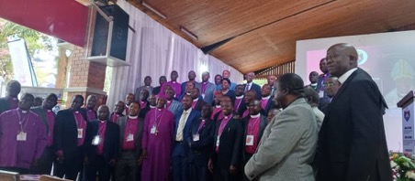
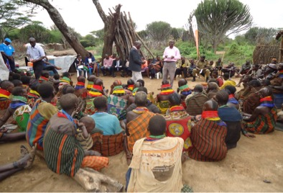
Stigma Reduction
Engaged various actors on stigma reduction
  Faith institutions
  Police
  Students Associations
  Parliament
  Cultural leadership
Conducted HIV Stigma & Discrimination survey
  Stigma 15% overall, higher among KP (16.6%) than gen pop. 14%.
Translated Stigma &Discrimination policy into sign language
Capacity building for health workers
  Disability inclusion
  Provision of KP friendly services
Notes:
Efforts to reduce Stigma continue accross the various sectors including cultural, religious groups as well Parliament
A Stigma and Districrimination survey was conducted for HIV and the findings are being used to improve interventions. Of note, stigma was 15% overall, higher among KP (16.6%) than the general population at 14%. This is corroborated by the Integrated Biobehaviuoral Surveillance (IBBS) surveillance that reported that among sex workers, 17% had experienced health care stigma in previous 6 months.
To improve information sharing, the stigma and discrimination policy was translated into sign language
There are continued efforts to ensure equitable access to services including for vulnerable populations such as People with Disability, and KPs. Capacity building for helath care workers has continued in disbaility inclusion and provision of KP friendly services

Slide 22
Economic & Psycho-social Responses
Integrated training for teachers in Sexuality Education, Gender Based Violence, HIV, teenage pregnancy, and mental health:
  320 teachers across 9 districts, 192 DEOs
Economic empowerment for KPs, PLHIV, Youth etc
  NAFOPHANU provided training in Village Saving schemes
  Reach Out Mbuya (ROM) reached 17,174 OVC households in FY24 Q3
  Youth skilling: The Presidential Initiative on Skilling the Girl, Boy Child reached 13,200 in the 22 skilling hubs in the country, each hub skilling an average of 600 youth annually.
  Youth Alive Uganda (YAU) empowered 1500 youth with soft and hard skills
  HIV prevention services in the Parish development model (PDM)
Education: A cumulative total of 40,000 most vulnerable girls who were on the verge of dropping out school have benefited from education subsidies between 2021 and 2023
Notes:
Efforts to strengthen social and economic protection to reduce vulnerability to HIV and AIDS mitigate its impact continued.
The MOES integrated training for teachers in Sexuality Education, Gender Based Violence, HIV, teenage pregnancy, and mental health: so far 192 DEOs & 320 teachers trained
Through various initiatives in GOU and private sector, economic empowerment for KPs, PLHIV, Youth etc was provided; as seen on slide
NAFOPHANU provided training in Village Saving schemes
Reach Out Mbuya (ROM) reached 17,174 OVC households in FY24 Q3
Youth skilling: The Presidential Initiative on Skilling the Girl, Boy Child reached 13,200 in the 22 skilling hubs in the country, each hub skilling an average of 600 youth annually.
Youth Alive Uganda (YAU) empowered 1500 youth with soft and hard skills
HIV services were integrated in the Parish development model (PDM)
Education: A cumulative total of 40,000 most vulnerable girls who were on the verge of dropping out school have benefited from education subsidies between 2021 and 2023

Slide 23
Gender Based Violence
A total of 120 District Action Centers (DACs) were established for reporting on GBV
Expanded the national GBV database to 54/135 districts
The National Child Policy was disseminated
The national parenting manual was completed, with more than 50,000 caregivers empowered with skills to identify risks and respond to violence against children (VAC).
Mental health and psychosocial support (MHPSS) were integrated into the SAUTI 116 helpline thus improving the counselling services to children and young adults.

Slide 24
Legal & policy framework for PLHIV,
KPs & Vulnerable Groups
National Multisectoral M&E framework was developed
Continued implementation of the Equity Plan Response:
  Enabling policy guidance in place e.g. Stigma & Discrimination guidelines; Legal & Environmental Assessments; School re-entry Guidelines; Advocacy for legal reforms; Adaptation strategy following AHA
MOH approved position of sign language translator at health facilities and centrally
Advocacy for law reform and strategic litigation against punitive aspects of the law are on-going led by CSO partners
Improved access to legal aid and other services for KP, PWD and other vulnerable groups

Slide 25
SYSTEM STRENGTHENING

Slide 26
Key achievements
Improved multi-sectoral coordination
  Online accreditation system was established for NGOs
Rolled out digital health information systems, including EMRs
Strengthened Lab quality management systems (Lab QMS)
  73 laboratories internationally accredited
Onboarded Community Health Extension Workers (CHEWS)
Strengthened RRHs: to support Districts-Led Programming
Strengthened HIV&AIDS mainstreaming in all government sectors
Development of National HIV and AIDS Sustainability Framework ongoing
Notes:
Key areas of improvement included;
An online accreditation systems for HIV services NGOs was established to ease coordination
The MOH rolled out digital health information systems, including Electronic Medical Records (EMR) to improve efficiency in service delivery
In the lab sector, a total of 73 laboratories were internationally accredited, an increase from 40 in the previous year.
The MOH onboarded Community Health Extension Workers (CHEWS) to bring services closer to the community
As part of decentralization, efforts to strengthen Regional Referral Hospitals continue to enable them support District-Led Programming

Slide 27
Funding contributions 2023/24
Over UGX 2.5 Trillion was mobilized for the HIV response
GOU direct funding was UGX 310Bn: (13%) of total
Through ‘Mainstreaming’, about UGX 61.9Bn
Challenges:
  Sustainability concerns
  Gaps in funding HIV Prevention, accountability and resource tracking
Notes:
Over UGX 2.5 Trillion ($690 million USD) was mobilized through GOU & development partners including PEPFAR, other bilateral and Multilateral organizations including GF, UN agencies etc. We are thankful.
Of the funds received, 80% was from donors, 15% from GOU.
Of note, direct GOU contribution has increased gradually over the years from $79.5m in 2020/21 to $83.7m in 2023/24 (UGX 310Bn) representing 13% of the total funds mobilized.
Through ‘Mainstreaming’, an additional about 61.9 billion UGX was made available to support HIV activities in the GOU sectors - MDAs and LGs.
However, there are still gaps in funding especially for HIV prevention interventions, and tracking utilization of available resources
The country’s ongoing efforts to develop the National HIV and AIDS Sustainability Framework is identifying pathways to change the HIV Programming models to make it less costly

Slide 28
Resource Tracking
Conducted National AIDS Spending Assessment for 2019/20 & 2020/21
  >45% spent on commodities
  Care & treatment: 60%
  Prevention: 12-13 %
  Social support: 3%
  HTS: 3-5%
  System strengthening: 18%
  KP: <1%
Conducted an assessment on HIV mainstreaming across sectors
Started institutionalization of expenditure tracking using online tool
Notes:
As part of resource tracking, a National AIDS Spending Assessment was conducted covering the period 2019/20 and 2020/21. Of note,
About 80% of the resources allocated to support the response were from donors.
The bulk of funds went towards HIV care and treatment –( 60%) while almost half of the funds (45%) was spent on procurement of commodities (HIV test kits, laboratory reagents, and ARVs). This has implications for sustainability.
In addition, there are efforts to integrate expenditure tracking by NASA and NHA, which will enable us undertake these 2 exercises more frequently and ensure data is available in real time.

Slide 29
Presidential Fast Track Initiative (PFTI)
Pillar | Progress 2023/24
Revitalize HIV Prevention (and close the tap on new HIV infections, particularly among AGYW) | 153 million condoms distributed, a met need of 62%. AGYW services expanded to 44 from 43 districts and program was reviewed. A package of services for Adolescent Boys and Young Men (ABYM) was developed. Overall, 543,990 AGYW were served with at least one HIV prevention intervention Presidential Initiative on Skilling the Girl, Boy Child reached 13,200 in the 22 skilling hubs 29,284 high-risk AGYW were reached with a defined package of HIV prevention programs 27,733 School Leaners were reached with Menstrual hygiene (1,259), Education/School subsidies (11,302) and health HIV and AIDS prevention messages (15,172). Roll out of the sexuality education framework continued.
Consolidate progress on eliminating Mother-To-Child transmission of HIV | 98% of mothers attending ANC had an HIV test; 95% of HIV infected mothers received ART; with 92% of mothers at 1st ANC virally suppressed, 94% tested for syphilis and 62% tested for HBV. Among HIV-Exposed Infants, 90% had EID testing, with 81% tested within 8 weeks. Among infants tested,3% tested HIV positive within 8 weeks and 5% after breastfeeding
Accelerate Implementation of ‘Test and treat’ and attain the 90-90-90 targets | Overall- 92% of PLHIV know their status; of these, 90% are on ART; of which 94% are virally suppressed (Overall: 92-90-94) Overall: 92-90-94 Adults: 93-90-95, with both male and female attaining the 3rd 95 Children 0-14 years 83-92-82 Adult males: 90-88-95 Adult females: 94-92-95
Address financing sustainability for the HIV response | HIV mainstreaming in MDAs & Local Governments strengthened: 98% of MDAs and 89% of LG have mainstreamed HIV. UGX 61 billion was mobilized 2023/24 through mainstreaming An assessment of HIV Mainstreaming was conducted A National AIDS Spending Assessment was conducted A national HIV response Sustainability Framework is under development with a clear roadmap
Ensure Institutional effectiveness for a well-coordinated multi -sectoral response | A total of 83% Self Coordinating Entities (SCEs) have functional HIV/AIDS Committees Government Ministries Departments and Agencies (MDAs) were supported to mainstream HIV/AIDS; establish HIV/AIDS committees, develop strategic plans, annual workplans, and workplace policies Coordination structures were revitalized at district level, within MDAs, Local Government, and at sub county The Education Management Information System (eMIS) was operationalized MOGLSD rolled out the national GBV database
Notes:
The slide summarizes achievements along the pillars of the Presidental Fast Track Initiative- already presented in previous sections

Slide 30
Key issues & Way forward
Children & adolescents’ lagging | Renewed focus on children and adolescents
Suboptimal coverage of HIV prevention services; especially reaching young people | Increase funding for HIV prevention Priority to adolescents and young people
Persistent structural barriers i.e. stigma, GBV, punitive laws | Conduct program evaluations Rethink ‘theory of change’ to better address structural barriers
Suboptimal retention in care | Enhance differentiated client retention
Coordination gaps esp. subnational level | Strengthen coordination at all levels
Significant mortality among PLHIV | Enhance early diagnosis & service integration
Sustainability concerns / reliance on external funding | Finalize sustainability framework and roadmap
Data quality gaps Fragmented reporting for GBV, AGYW Missing data e.g. for behavioral indicators, KP size estimates | Harmonize reporting systems Review indicators for relevance and feasibility Determine population size estimates
Notes:
Several key challenges need to be addressed if we are to realise the NSP targets, and ultimately the goal of Ending AIDS as a Public Health Threat by 2030:
Childen, adolescents and young people continue to lag behind in our HIV response and need special focus -- not forgeting 70% of the population is under 30 years- according to the 2024 census
Structural barriers such as stigma, gender –based violence, and human rights violations have persisted despite ongoing efforts
Coordination of the response though much improved at national level, still has gaps at subnational level
To improve outcomes and reduce mortality among PLHIV, we need to detect infected persons early, initiate them on ART, support them to stay on treatment, and strengthen health service integration
The reliance on external funding for our response needs to be addressed. I therefore call upon all stakeholders to join hands as we develop the HIV Sustainability Roadmap

