Slide 1
Mortality Among People Living with HIV in the era of Antiretroviral Therapy: Observations from MJAP East Central Region and Kiruddu National Referral Hospital (2020-2024)
Dr. Paul Lwevola, MBChB, MPH, ImS Fellow
HIV/TB care and Treatment Advisor, MJAP
Dr. Wanda Yvone, MBChB
Medical officer, MJAP

Slide 2
Background
Before ART (2003), HIV mortality in Uganda was high (>78,000 deaths/year)
Uganda started distributing free antiretrovirals-2004
AIDS mortality deaths reduced from >78,000 in 2003, to 60,000 in 2010 and 20,000 by 2022
ART: Antiretroviral Therapy; AIDS: Acquired Immunodeficiency Syndrome

Slide 3
Causes of death before and after ART: Declining communicable and AIDS defining malignancies to chronic non-communicable conditions
Before ART
Tuberculosis
Other infections
Cryptococcal meningitis
Bacterial infections (Pneumonia, Bacteremia, GI infections
Cytomegalovirus infections
Hepatitis B and C
HIV wasting syndrome (wasting, muscle atrophy, chronic diarrhea)
HIV defining cancers-Kaposis sarcoma
Test and Treat era
Non-communicable diseases
Cardiovascular diseases, diabetes, chronic kidney disease, mental health issues (depression & substance abuse)
AIDS related deaths despite ART
Advanced HIV disease (TB)
ART failure
Non-AIDS defining cancers
Liver cancer, lunger cancer, cancer of the cervix
Kalyesubula et al. (2019); Nasuuna et al. (2020); Hermans et al. (2017); Castro et al. (2021); Ocama et al. (2018); Kintu et al. (2022); Byaruhanga et al. (2021); Cox et all., 2016

Slide 4
Objectives
To describe mortality among PLHIV receiving care from the MJAP program
East Central region: The community-based program (October 2021-September 2024) -to gain insights into the public health aspects of the program
Central region: The hospital-based program at Kiruddu National Referral Hospital in Kampala (2020-2024) - to gain insights into the clinical care aspects of the program
To better understand the reasons why people with HIV are dying in the era of Antiretroviral Therapy

Slide 5
Methods: Community based program – East Central region
The MJAP program in the EC is a USAID funded 5-year (2021-2026) activity supporting public health facilities to improve accessibility, availability and utilization of comprehensive HIV/TB services
Coverage includes the 11 districts of Busoga region and Jinja City; Busia district-Bukedi region
Building capacity of public health facilities to notify, audit and certify HIV/TB deaths at HC IVs and district hospitals
Previously trained Community Health Workers (CHWs) conduct verbal autopsies following community deaths using the NIRA verbal autopsy form
Deaths occurring at facilities are audited monthly at a facility meeting (HC IVs and above)
NIRA: National Identification and Registration Authority

Slide 6
Methods: Hospital based program - Central Region
MJAP collaboration with Kiruddu Hospital started in 2020
To reduce high mortality (31%) among clients among presenting with Advanced HIV Disease (AHD)
Supports clinical, laboratory and radiological services to patients with AHD
Mortality documentation
Mortality audit meetings done monthly
Facility team: doctors, clinical officers, nurses, laboratory technicians, nutritionists, administrative staff
Review deaths that occurred at the facility in the last month
Identify factors associated with the death; ascertain possible causes, prevalent OIs and comorbidities at admission
Engagement of hospital administration at subsequent feedback meetings

Slide 7
Data collection
At community level: CHWs conduct verbal autopsy, document possible causes of deaths and report through the facility level surveillance focal persons
At facility level, mortality audit findings are documented and reported in DHIS2 (monthly) and the PEPFAR reporting systems (quarterly)
Deaths analyzed quarterly, disaggregated by possible cause, age and sex.

Slide 8
Data analysis for this report
Describing mortality
Community program - estimated proportion dying out of all PLHIV in care
Hospital program - estimated proportion dying out of all PLHIV admissions
Causes of death
Estimated proportions in each category of the PEPFAR classification of causes of death
We also captured anecdotes from verbal autopsy reports for community deaths
Note: Cause of death is equivalent to a patient having that specific diagnosis at the time of death (as assigned by the last physician to review the client before death)

Slide 9
Classification of causes of death among PLHIV (PEPFAR-TX-ML MER guide)
Classification | Inclusions
HIV Disease resulting in TB | Tuberculosis
HIV Disease resulting in other infections and parasitic diseases | Hepatitis B, C&D, COVID 19, Malaria, GI infections other than TB
HIV Disease resulting in Cancers | Includes HIV and non-HIV related cancers (CXCA, Kaposis, HCC)
Non-infectious/non-malignant causes related to HIV | Acute HIV syndrome, generalized lymphadenopathy, hematological and immunological abnormalities, organ failures
Other Natural causes not directly related to HIV | Cardiovascular, Kidney, Liver diseases, mental disorders, metabolic disorders, borne disorders
Non-natural causes | Trauma, Suicide, Accidents, Injury
Unknown | Unknown in these data means that the death is not yet audited

Slide 10
Mortality proportions - Community program
Thru 1st Oct 2021 – 30th Sept 2024; a total of 1,784 deaths were reported among all PLHIV in care
52% male
95% aged 15+yrs.
On average, 149 deaths were reported per quarter during the analysis period, representing 0.2% mortality per quarter (average Tx-Curr: 66,772 clients)
A total of 743 deaths out of 1,784 (42%) were audited.

Slide 11
Bugiri Hospital Case Study
For the period October 2023 to sept 2024, the hospital reported 32 PLHIV deaths
23/32 (72%) of deaths occurred in the community
Verbal autopsies were conducted in 18/23 (78%)
Cause of death could not be established in 9/18 (50%) deaths
Quotes from linkage facilitators who do verbal autopsies
“When the clients get symptoms, they are rushed to the nearest clinics where they die. If you do the autopsy early, you may get some records at the clinics or with family members”
“We learn of the clients' death usually after a month and beyond, after they miss appointment; at this time, most family members have lost related medical records”
“family members report symptoms like headache, fever, vomiting etc, then the client died, which makes it difficult to establish the cause of death”.
“We need more training to be able to question symptoms and signs to establish cause of death, the verbal autopsy form also needs revision to capture symptoms”

Slide 12
Mortality trends among PLHIV with AHD - Kiruddu National Referral Hospital MJAP Program 2020-2024
Baseline mortality before starting the mortality audits was at 31%.
Thru March 2020 to September 2024, mortality ranged from 22% to 26%.
Suggesting mortality is unacceptably still high (Expected mortality at Kiruddu is estimated at 10%)

Slide 13
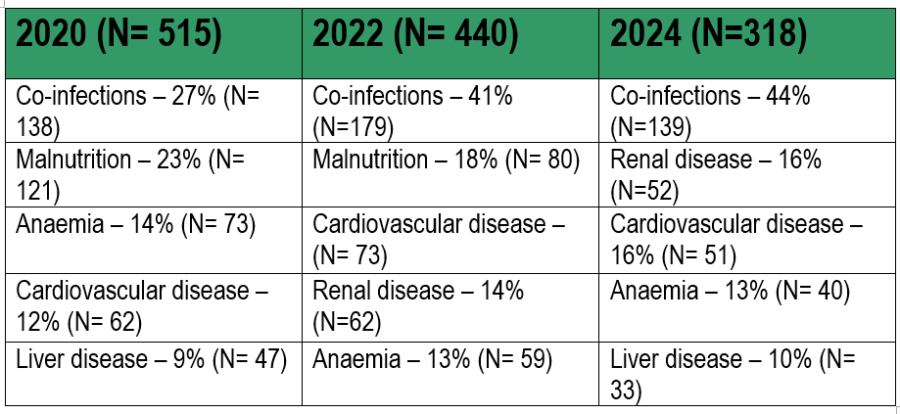
Mortality over the years and common diagnoses at death
Co –infections include; pneumonia, malaria, urinary tract infections, gastro-enteritis, bacteremia and H. pylori infection.

Slide 14
Characteristics of HIV in-patients at KNRH from October 2023 to September 2024

Slide 15
OIs and comorbidities among HIV inpatients at KNRH from October 2023 to September 2024

Slide 16
Conclusions - the community program
Mortality in the community program is generally low
However, majority of the deaths occur in the community and not at the facilities
Natural causes leading cause of death (cardiovascular, kidney, Liver diseases, mental disorders, metabolic disorders, borne disorders)
Verbal autopsies were useful but with challenges e.g., timeliness of conducting the autopsies

Slide 17
Conclusions - the Hospital program
Mortality is still unacceptably high for PLHIV inpatients
Sepsis and infections are common and persisting over time
Functional assessment at admission was predictive of mortality
TB is still common as a diagnosis at death
For comorbidities, cardiovascular disease, malnutrition, renal disease and anemia were all common among admitted PLHIV

Slide 18
Best practices
Training of community and facility health workers on death audits and verbal autopsies
Printing and availing mortality audit tools (HIV/TB mortality audit tools, HMIS 100 forms and verbal autopsy forms)
Monthly reports of deaths and audits by HC IVs and Hospitals are being submitted to program at increased coverage
Multi-disciplinary review of audit findings to address quality of care happening more frequently

Slide 19
Recommendations for improved programming
Provide more training and tools for health workers to audit and report deaths
Targeted interventions for PLHIV (timely seeking of care, sensitization on healthy living)
Strengthen tertiary care in HIV programs, e.g., the Kiruddu Hospital Program
Treatment program should pay more attention to cardiovascular disease, malnutrition, renal disease and anemia
Novel interventions to improve community death surveillance and autopsy processes

Slide 20
Next steps for scientific investigation
Complete the auditing of all deaths in the program
Provide mentorship to health workers to improve skills in conducting verbal autopsies and explore best approaches for doing this.
More studies to better understand deaths happening in the community
Evaluate and address data gaps at facility audits and community autopsies
Engage different stakeholders on more systemic analysis of mortality in MJAP and in the general HIV and AIDS program

Slide 21
Acknowledgements
Entities
Ministry of Health
PEPFAR
USAID
CDC
Uganda AIDS Commission
MJAP
Implementing partners
District Local governments
PLHIV networks
Individuals
Dr. Fred Semitala
Dr. Michael Kiyingi
Dr. Rogers Katwesigye
Mr. Nelson Mugume
Mr. Wilson Musene
Mr. Shafik Malende
Dr. Seremba Emmanuel
Dr. Asiimwe Stephen

Slide 22
Thank You
USAID’s Local Partner Health Services-East Central Activity and the Kirrudu Hospital AHD Program are implemented by Makerere University Joint AIDS Program (MJAP) with support from United States Agency for International Development (USAID) and Centers for Disease Control (CDC).

